Slide 1
Graph-Based Clickstream Analysis
for Web Navigation and User Behavior
Project Presentation
Abstract • Objectives • Implementation • Results
GRAPH AND WEB ANALYTICS – SEC 4
TEAM MEMBERS:
G SHEETAL – 2320030092
R BRAMHANI – 2320030104
P RAGA AMRURTHA RATNA - 2320030355
Products
Home
Cart
Academic project

Slide 2
Abstract
WebGraph Analytics is a Streamlit-based dashboard that analyzes how users navigate between webpages using clickstream data. The system prepares page-view records, orders visits chronologically, and identifies transitions between consecutive pages. These transitions are represented as a directed graph, where webpages are nodes, movements are edges, and transition frequency is the edge weight. Graph algorithms such as Dijkstra’s shortest path, centrality measures, PageRank, and community detection help explore page relationships and navigation patterns. The dashboard also presents web analytics visualizations, accepts CSV and Excel uploads, and supports downloading analysis outputs as CSV files.
Input
Processing
Output
Clickstream records and page visits
Journeys and graph analytics
Interactive dashboard and CSV results
WEBGRAPH ANALYTICS
02

Slide 3
Problem Statement
The challenge
Why it matters
Traditional analytics commonly summarizes page views, users, sessions and traffic sources. Raw clickstream records do not always make relationships between consecutive page visits easy to explore.
Navigation paths can be difficult to understand from raw rows.
Important or connecting webpages may not be obvious.
Related groups of pages can be hard to identify visually.
Analysts need a clear way to inspect page-to-page transitions.
Problem to solve
Transform clickstream records into a graph that reveals page-to-page relationships and supports navigation analysis.
WEBGRAPH ANALYTICS
03

Slide 4
Project Objectives
Analyze journeys
Build a graph
Find important pages
Organize page visits in chronological order.
Represent pages as nodes and transitions as weighted directed edges.
Use centrality measures and PageRank to analyze webpage importance.
Explore navigation paths
Identify communities
Present insights
Apply shortest-path analysis between selected pages.
Find groups of closely connected webpages.
Show graph and web analytics in an interactive dashboard.
WEBGRAPH ANALYTICS
04

Slide 5
Existing Solutions and Their Drawbacks
Traditional web analytics
Tabular clickstream analysis
Summarizes page views, users, sessions, conversions and traffic sources.
Stores events as rows and often requires additional grouping or manual exploration.
Common drawbacks
Page-to-page relationships may not be represented explicitly.
Finding paths between pages may require extra analysis.
Central or bridging pages can be difficult to spot in tables.
Groups of related webpages may not be clear from summary charts alone.
WEBGRAPH ANALYTICS
05

Slide 6
Our Project Innovation
WebGraph Analytics combines graph-based navigation analysis with an accessible, interactive dashboard.
Graph representation
Journey-based transitions
Multiple graph measures
Webpages become nodes; page transitions become directed, weighted edges.
Uses event order to identify consecutive page movements.
Combines paths, centrality, PageRank and community detection.
Interactive exploration
Flexible data input
Exportable outputs
Displays graph analytics and web analytics through Streamlit.
Supports a bundled dataset and user-uploaded CSV or Excel files.
Allows supported analysis results to be downloaded as CSV.
WEBGRAPH ANALYTICS
06

Slide 7
Advantages
Visual navigation
Path analysis
Makes page-to-page relationships easier to inspect.
Supports minimum-cost route exploration between webpages.
Page importance
Community insights
Provides several complementary graph measures.
Can reveal groups of strongly connected pages.
Flexible datasets
Reusable results
Allows analysis of bundled and uploaded data.
CSV exports support further analysis and reporting.
WEBGRAPH ANALYTICS
07

Slide 8
Modern Tools and Technologies
Python
Pandas
NumPy
NetworkX
Core programming language
Load, inspect and process tabular data
Numerical operations
Graph creation and graph algorithms
Streamlit
Plotly
Matplotlib & Seaborn
OpenPyXL
Interactive browser-based dashboard
Interactive charts
Data visualizations
Excel file reading support
Technology benefit
A Python-based stack brings data processing, graph analysis and interactive visualization together.
WEBGRAPH ANALYTICS
09

Slide 9
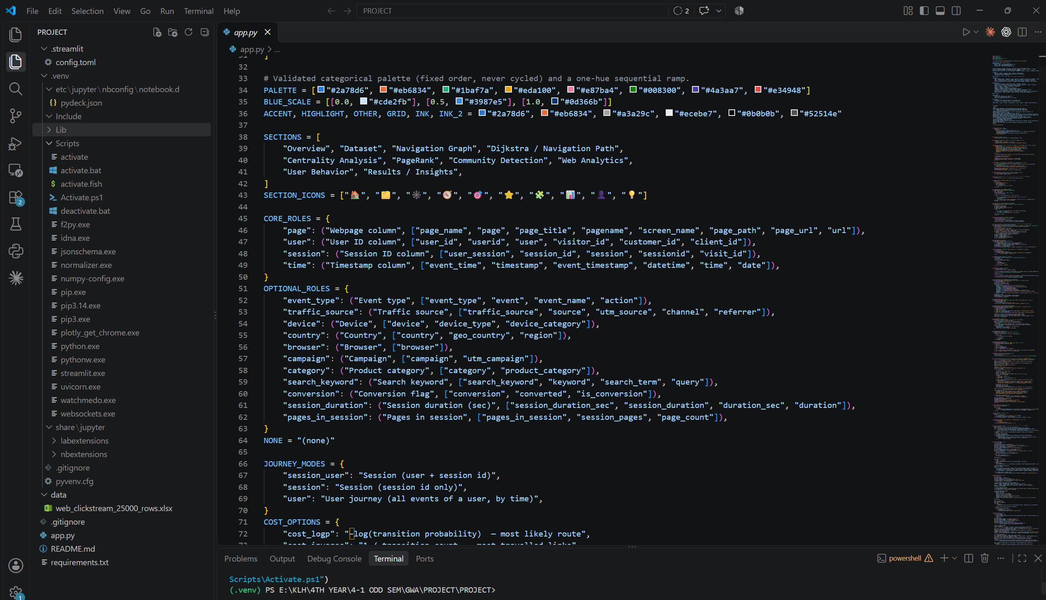
Implementation
1. Load data
2. Prepare data
Load the bundled dataset or accept a CSV/Excel upload.
Check the required fields and parse event timestamps.
3. Form journeys
4. Build graph
Sort page visits and identify each user's next page.
Count page-to-page transitions and assign edge weights.
5. Run analysis
6. Display results
Calculate shortest paths, centrality, PageRank and communities.
Show graph metrics, charts and available CSV downloads.
WEBGRAPH ANALYTICS
10

Slide 10
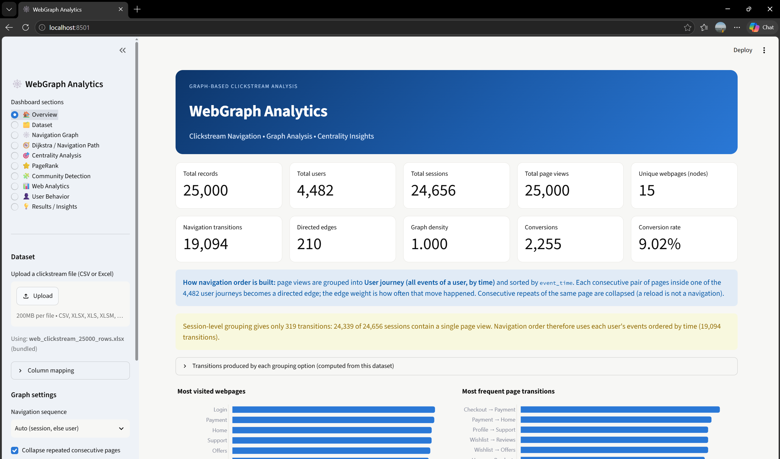
Solution and Results
Input
Prepare
Graph
Analyze
Present
Dataset / upload
Clean and order visits
Nodes + weighted edges
Paths and metrics
Dashboard + CSV
Outputs the dashboard can provide
Visual navigation graph and transition frequencies.
Graph statistics and webpage centrality / PageRank results.
Shortest-path and community detection views.
Web analytics charts and supported CSV exports.
WEBGRAPH ANALYTICS
11

Slide 11
CONCLUSION
Turning clickstream data into navigation insights
WebGraph Analytics transforms webpage visit records into a directed, weighted graph and applies graph algorithms to explore navigation paths, webpage importance and groups of related pages. Its Streamlit dashboard brings graph analytics and web analytics together in an interactive interface, with support for custom data uploads and CSV exports.
Represent
Analyze
Communicate
Webpages and user transitions as a graph
Paths, importance and communities
Dashboard views and CSV outputs
THANK YOU

